Slide 1
Red Ball Pizza Order System
Bayansuren Bayarsaikhan
Janardhan Bonu

Slide 2
Introduction
Pizza Order System is used by the Red Ball team member
Take pizza order from customer
Pizza Inventory monitoring

Slide 3
Project description
Order Take Module:
This module is used to take order from the customer. The Red Ball member will fill the order form according to the customer choice and confirm the order online.
Inventory Module:
This module is used to view the ingredients available status to make pizza.

Slide 4
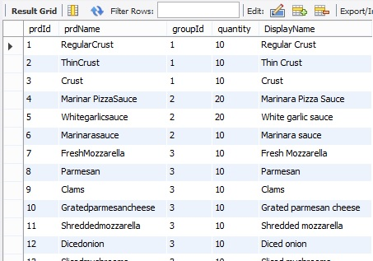
Database Design
Database is maintained only for inventory management in one table.

Slide 5
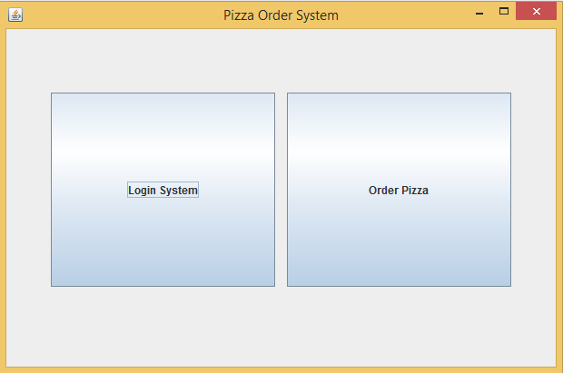
Demo – Main Screen

Slide 6
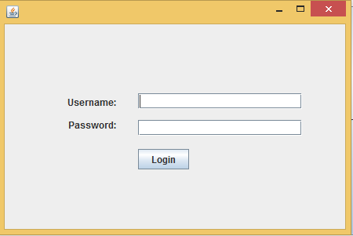
Demo – Login for inventory Screen

Slide 7
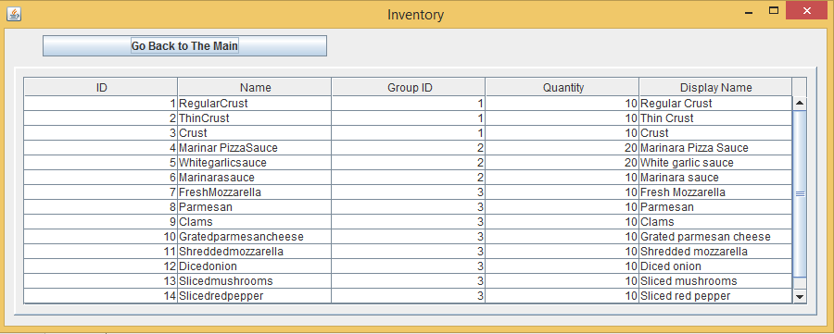
Demo – Inventory details Screen

Slide 8
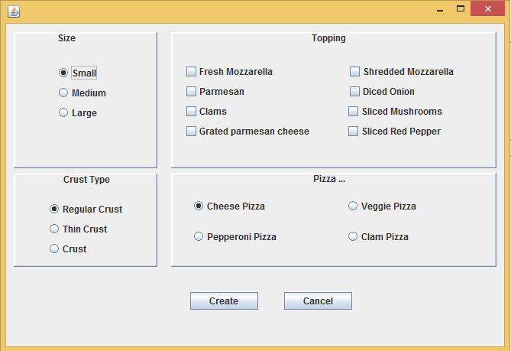
Demo – Pizza Take order Screen

Slide 9
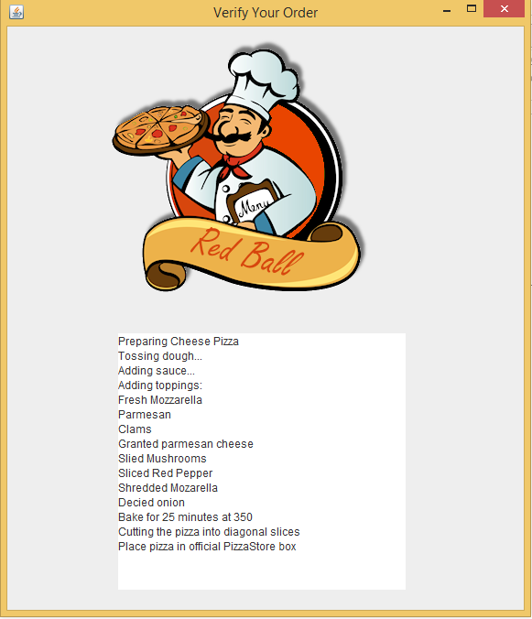
Demo – Pizza order status Screen

Slide 10
Conclusion
Red Ball team is able to take the pizza order from customer and monitor the inventory.
SCI: Do less and Accomplish more

